Slide 1

BJIT ACADEMY
CHORKI.com
MD. KHALID MAHMUD
ID: 11280
khalid.mahmud@bjitgroup.com
Image Placeholder

Slide 2
Introduction
The name of my application is “CHORKI”. It is a platform where user will be able to watch movies by buying packages. It is a flexible web application where people can enjoy unlimited movies/series with so many attractive facilities which are not be available in any other softwares.

Slide 3
Project Goal
Secured registration/login system.
OTP based login system
Complete both admin and user panel.
Add vast collection of movie for user
User will watch/like/dislike/comment in movie
User will buy attractive movie packages
User will be able to chat with admin.
Admin can track customers.
Admin can generate and view different charts

Slide 4
Technology
Front end: React JS
Backend: Laravel, MySql
Integration: Rest Api
Style: CSS
Mail: Mailtrap
Postman : For Testing API

Slide 5
Features (Basic)
Email verification based registration.
Secured login system
Design homepage with real time movie data.
View movies with details.
Play and pause movies.
Add movies to watch-later,
Search movies

Slide 6
Features(Medium)
View search history.
Buy attractive monthly/yearly packages
Check online/offline status
Customer can like/dislike/comment under movies.
Report comments.
View customers. (Admin)

Slide 7
Features(Advance)
OTP based login system.
Forget password facility.
Chat with admin
Check online/offline status.
Get the latest message at first position like messenger.
Add data for generating charts. (Admin)
View charts. (Admin)

Slide 8
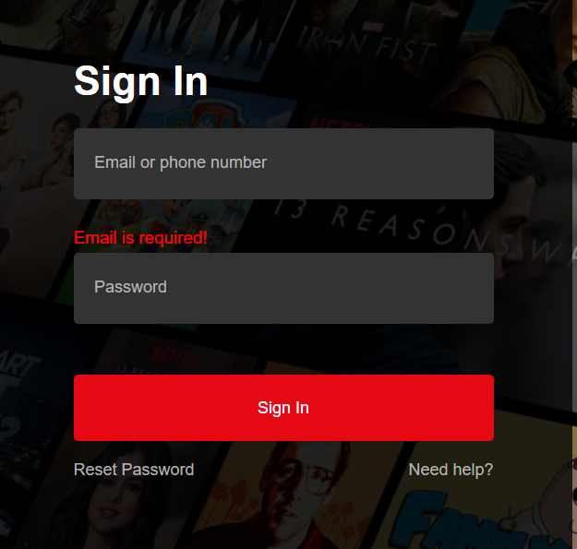
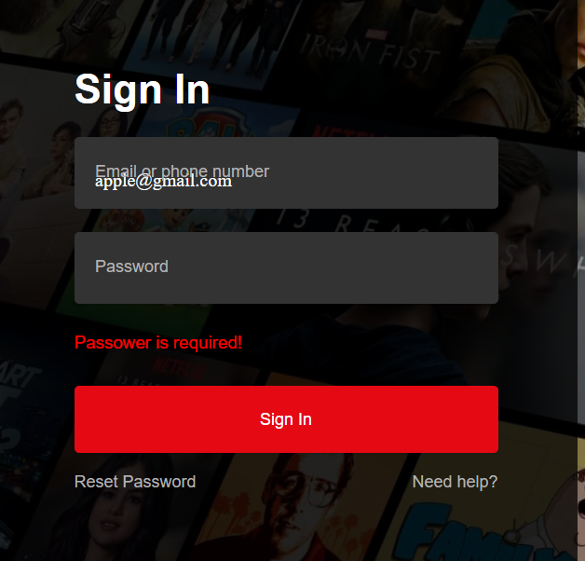
Snap Shots
Sign In Page Login with Form Validation

Slide 9
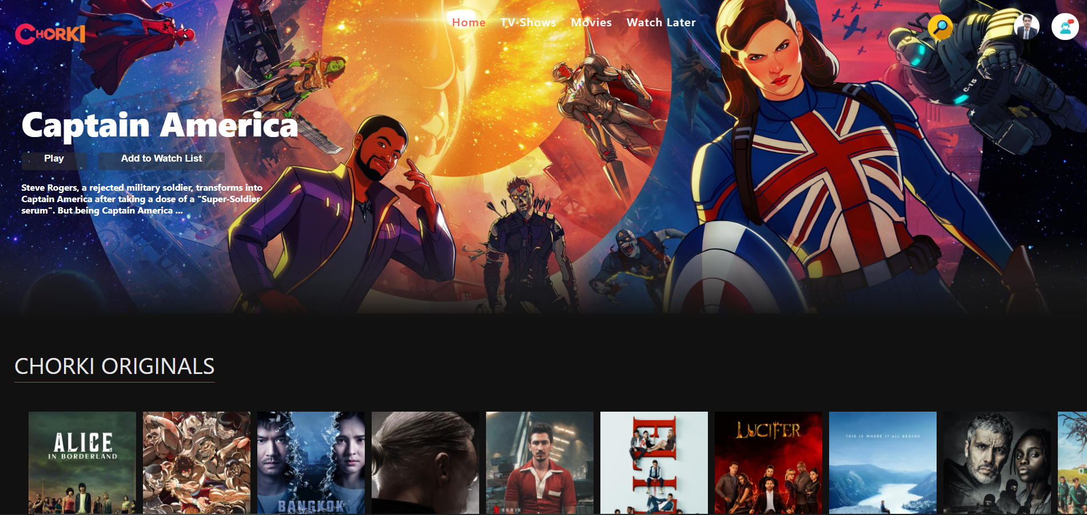
Snap Shots
User Side Home Page

Slide 10
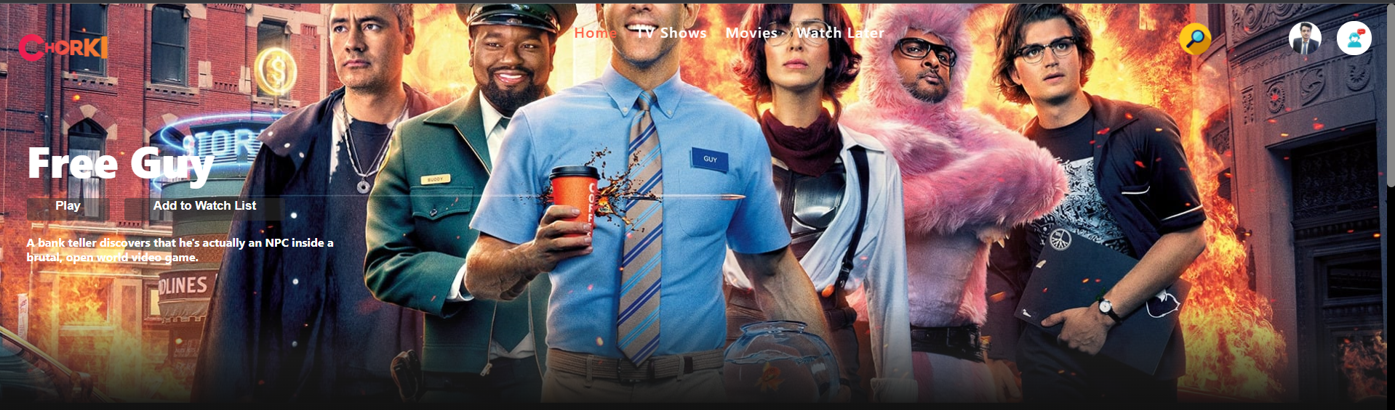
Snap Shots
Banner Page

Slide 11
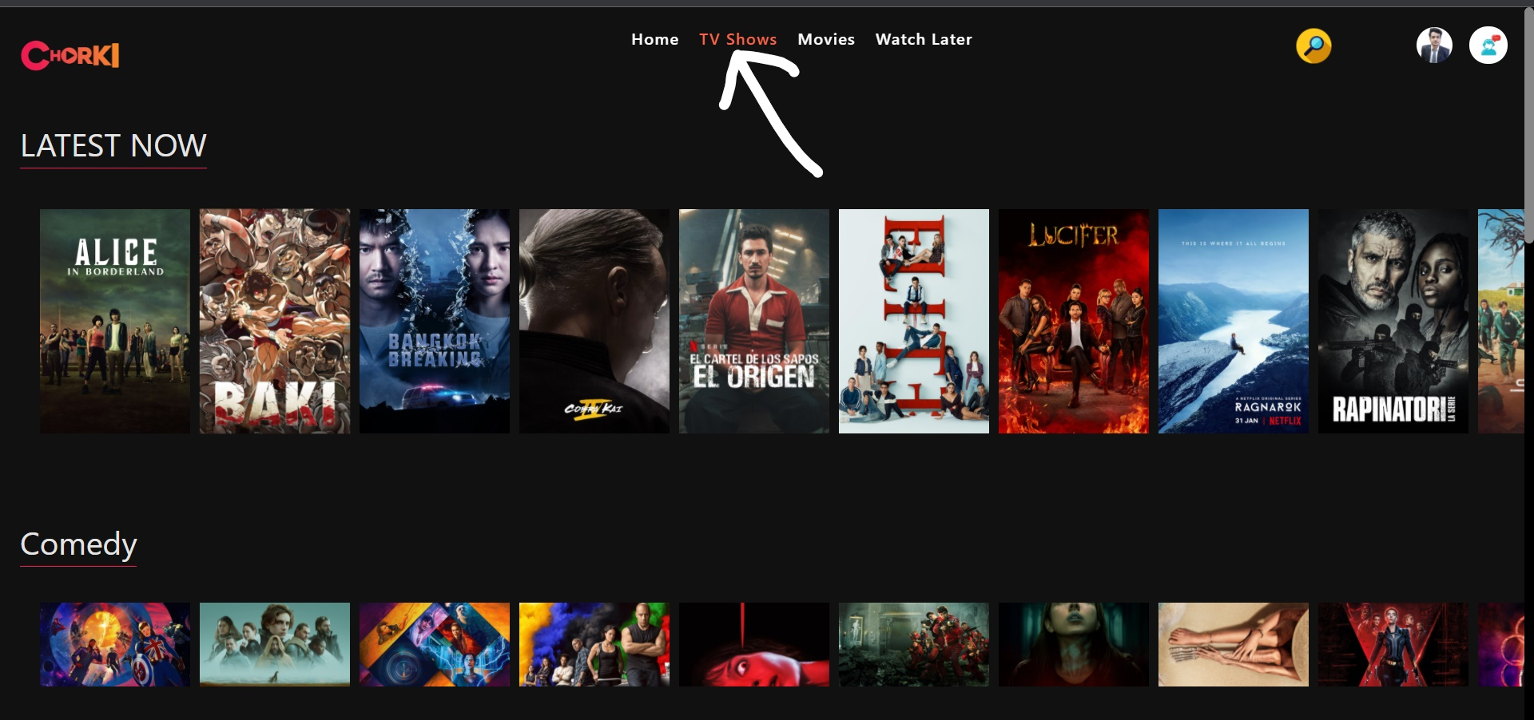
Snap Shots
Banner Page

Slide 12

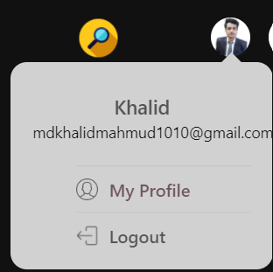
Snap Shots
Footer and Drop-down Menu

Slide 13

Snap Shots
Navbar

Slide 14
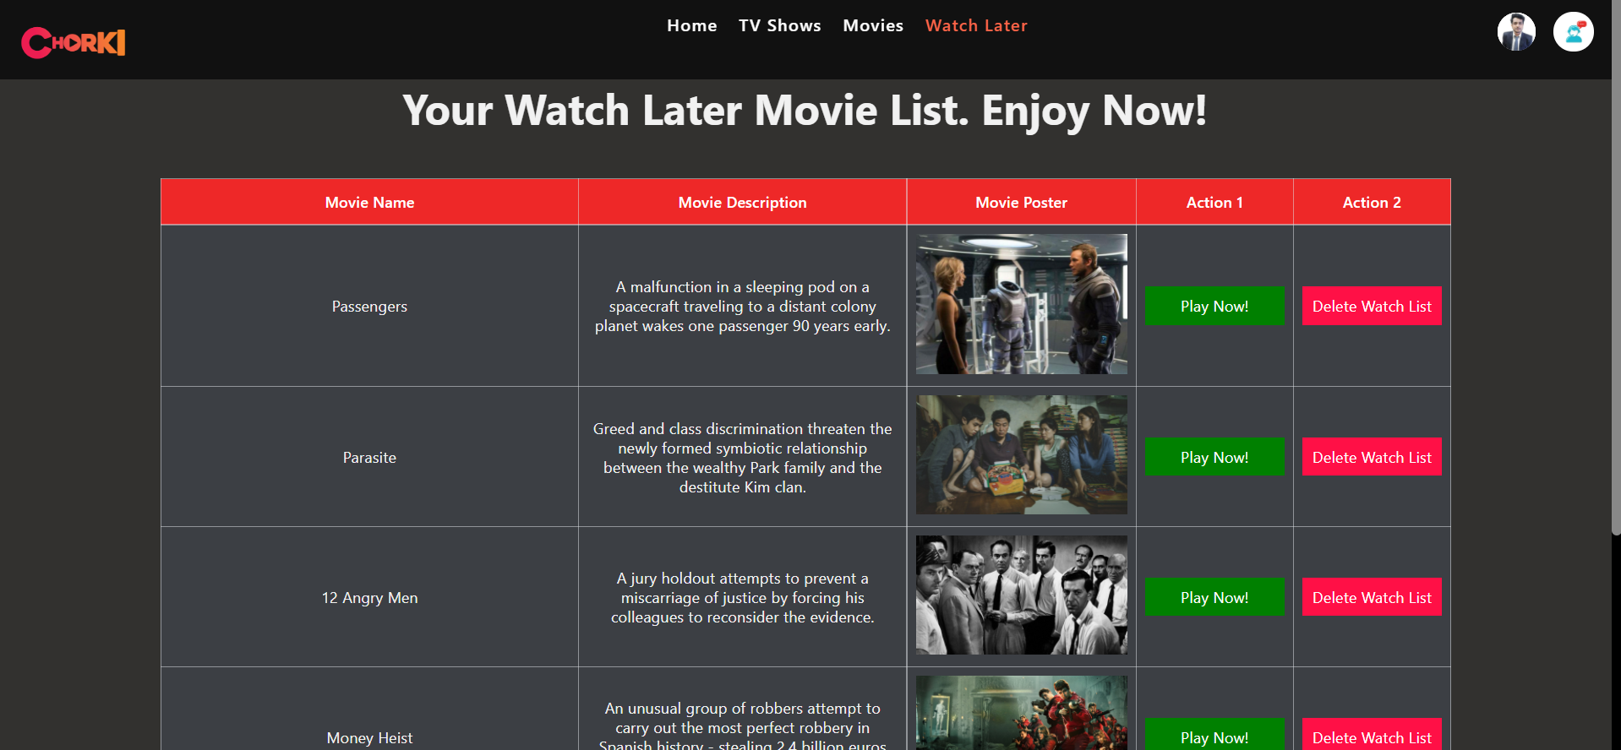
Snap Shots
Watch Later

Slide 15
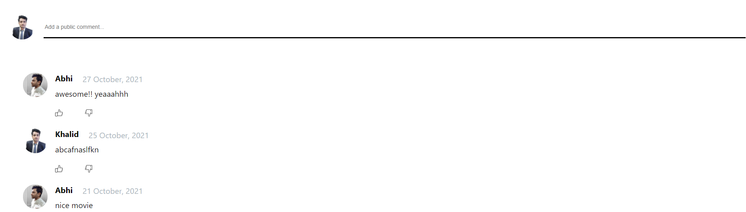
Snap Shots
Commmet Section under a specific Movie

Slide 16
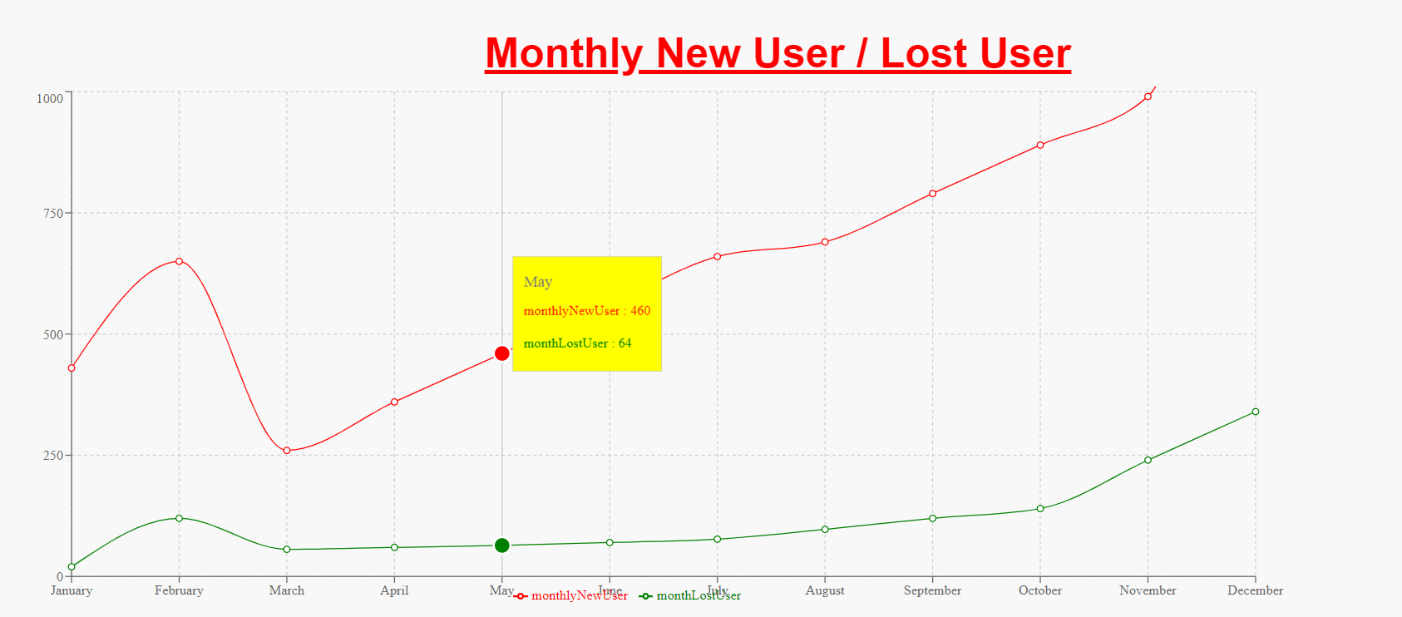
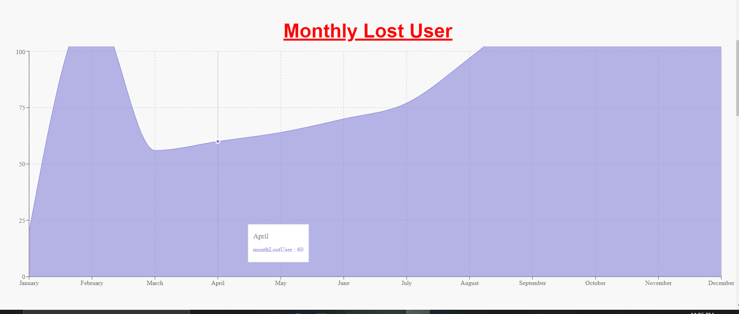
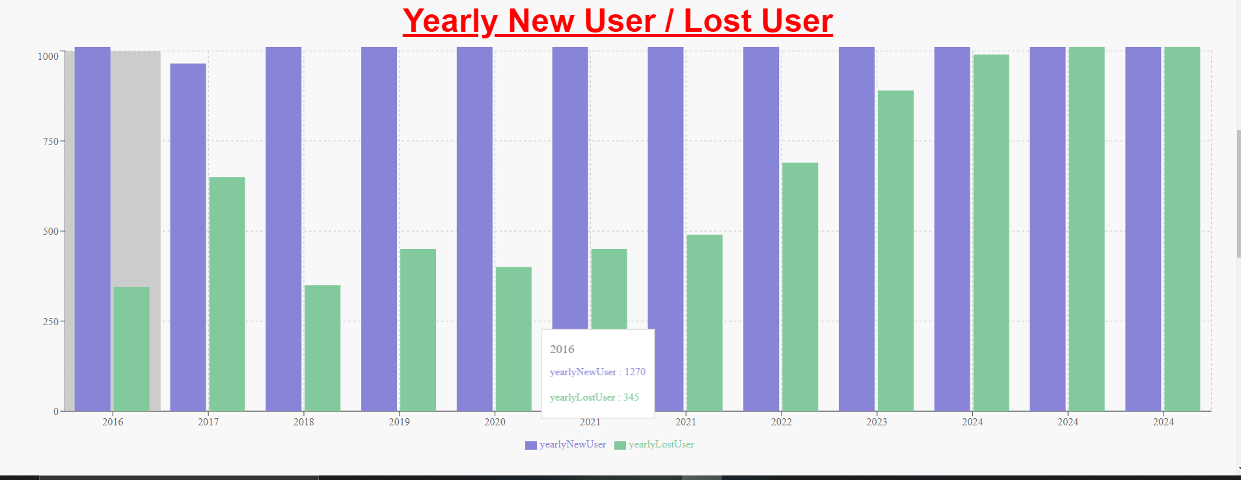
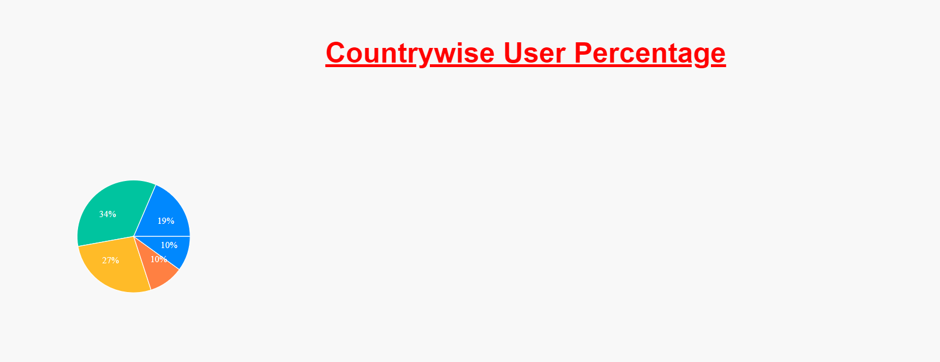
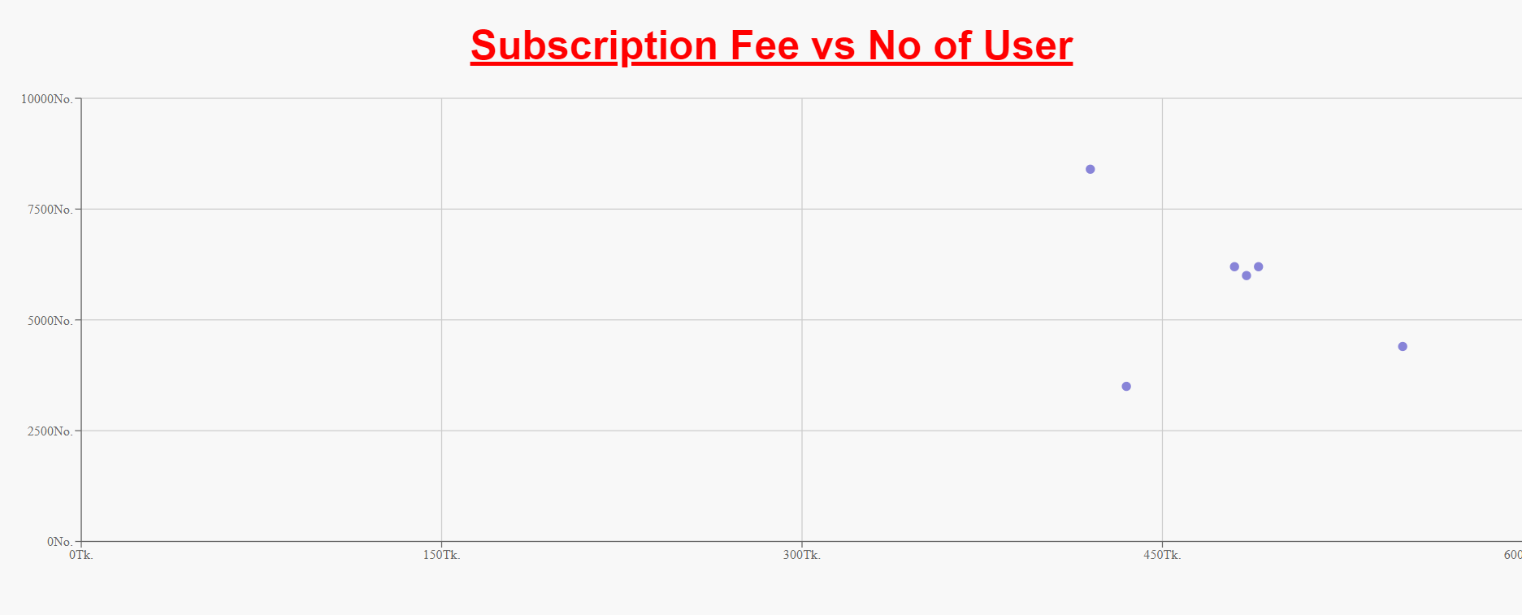
Snap Shots
Admin can view various types of chart

Slide 17
Thank you

